Slide 1
COVASIM Analysis P2
Produced: 10/20/2020

Slide 2
Compliance
What does compliance look like?

Slide 3
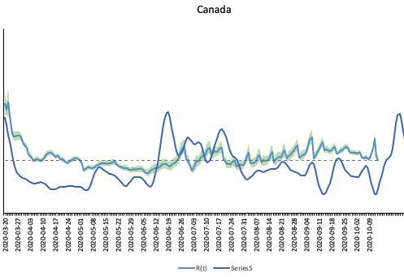
0 Compliance
High compliance to masks in community and NOT in schools ** No Values Changed Here From Orignial Model **
Community contacts reduction by 24% means 68% of normal during termtime and 53% during holidays from 24th Jul ** No Values Changed Here From Orignial Model **
Schools contacts normal ** No Values Changed Here From Orignial Model **
Masks NOT in secondary schools from 1st September ** No Values Changed Here From Orignial Model **

Slide 4
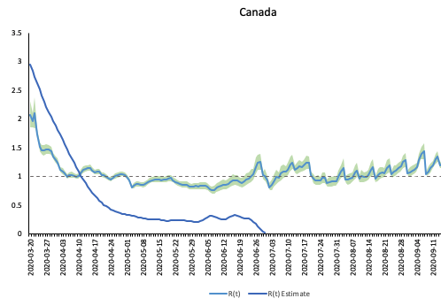
30% Compliance
Here we are looking at low compliance of masks when first introduced so we look at weeks April 7. So we take Rt Mar7 - April7 ROLLING BASIS
Community contacts reduction by 12% means 80% of normal during termtime and 62% during holidays from 24th July ** No Values Changed Here From Orignial Model **
Schools contacts reduction by 15% means 77% of normal during termtime from 1st Sep
masks in secondary schools from 1st September AVERAGE DATA FROM SEPT 1 - 0CT 20 2020

Slide 5
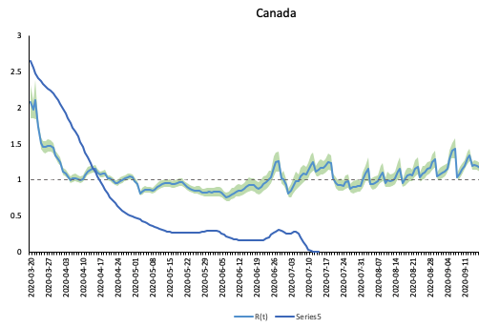
60% Compliance
Using A Rotation of Our Rt For High Compliance To Masks & COVASIM Values for High Compliance
Community contacts reduction by 24% means 68% of normal during termtime and 53% during holidays from 24th Jul ** No Values Changed Here From Original Model **
Schools contacts reduction by 30% means 63% of normal during termtime from 1st Sep
Masks in secondary schools from 1st September AVERAGE DATA FROM SEPT 1 - 0CT 20 2020

Slide 6
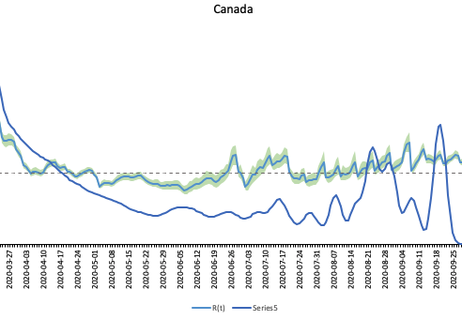
90% Compliance
High compliance to masks in community
Community contacts reduction by 12% means 80% of normal during termtime and 62% during holidays from 24th July ** No Values Changed Here From Orignial Model **
Schools contacts normal

